Slide 1
Introduction to Machine Learning and Data Mining (Học máy và Khai phá dữ liệu)
Khoat Than
School of Information and Communication Technology
Hanoi University of Science and Technology

Slide 2
Contents
Introduction to Machine Learning & Data Mining
Supervised learning
Unsupervised learning
Clustering
Practical advice

Slide 3
1. Basic learning problems
Supervised learning: learn a function y = f(x) from a given training set {{x₁, x₂, …, x_{N}}; {y₁, y₂,…, y_{N}}} so that y_{i} ≅ f(x_{i}) for every i.
Each training instance has a label/response.
Unsupervised learning: learn a function y = f(x) from a given training set {x₁, x₂, …, x_{N}}.
No response is available
Our target is the hidden structure in data.

Slide 4
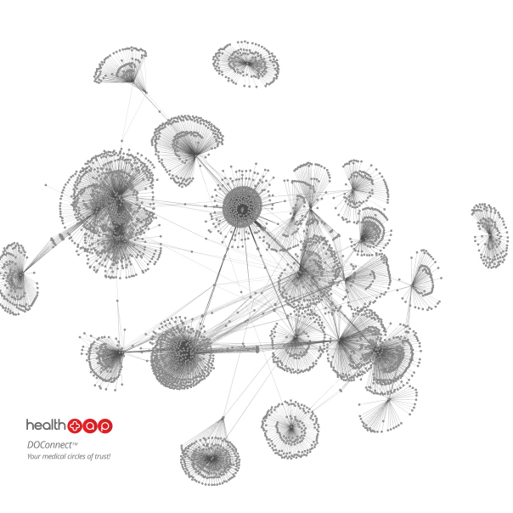
Unsupervised learning: examples (1)
Clustering data into clusters
Discover the data groups/clusters
Community detection
Detect communities in online social networks

Slide 5
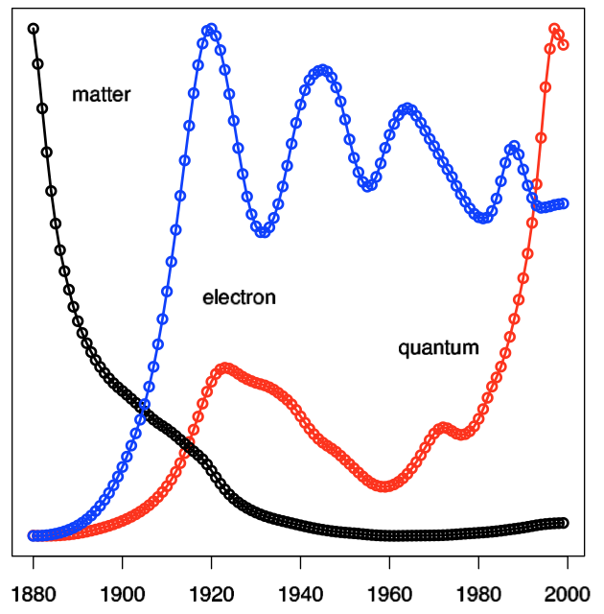
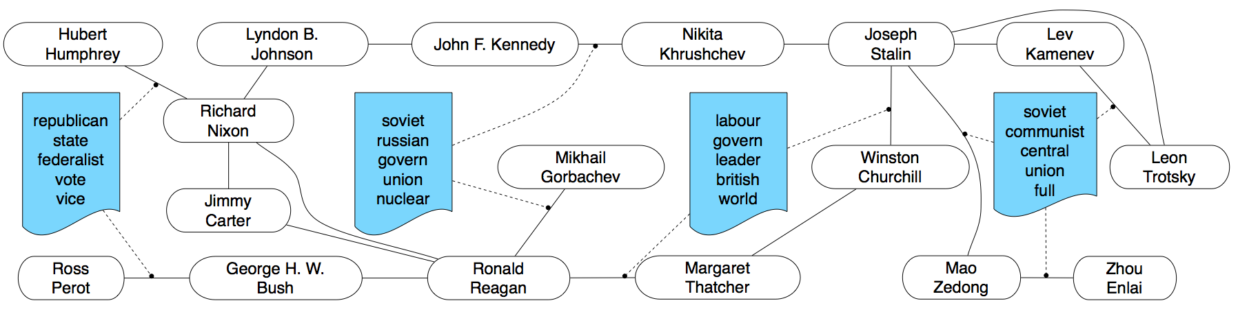
Unsupervised learning: examples (2)
Trends detection
Discover the trends, demands, future needs of online users
Entity-interaction analysis

Slide 6
2. Clustering
Clustering problem:
Input: a training set without any label.
Output: clusters of the training instances
A cluster:
Consists of similar instances in some senses.
Two clusters should be different from each other.
After clustering

Slide 7
Clustering
Approaches to clustering
Partition-based clustering
Hierarchical clustering
Mixture models
Deep clustering
…
Evaluation of clustering quality
Distance/difference between any two clusters should be large. (inter-cluster distance)
Difference between instances inside a cluster should be small.

Slide 8
3. K-means for clustering
K-means was first introduced by Lloyd in 1957.
K-means is the most popular method for clustering, which is partition-based.
Data representation: D = {x₁, x₂, …, x_{r}}, each x_{i} is a vector in the n-dimensional Euclidean space.
K-means partitions D into K clusters:
Each cluster has a central point which is called centroid.
K is a pre-specified constant.

Slide 9
K-means: main steps
Input: training data D, number K of clusters, and distance measure d(x,y).
Initialization: select randomly K instances in D as the initial centroids.
Repeat the following two steps until convergence
Step 1: for each instance, assign it to the cluster with nearest centroid.
Step 2: for each cluster, recompute its controid from all the instances assigned to that cluster.

Slide 10
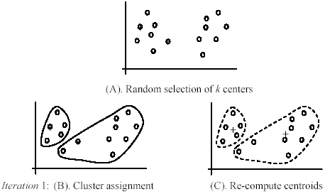
K-means: example (1)
NAFOSTED
Title
[Liu, 2006]

Slide 11
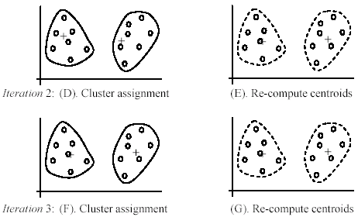
K-means: example (2)
[Liu, 2006]

Slide 12
K-means: convergence
The algorithm converges if:
Very few instances are reassigned to new clusters, or
The centroids do not change significantly, or
The following sum does not change significantly
Where C_{i} is the i^{th} cluster; m_{i} is the centroid of cluster C_{i}.

Slide 13
K-means: centroid, distance
Re-computation of the centroids:
m_{i} is the centroid of cluster C_{i}. |C_{i}| denotes the size of C_{i}.
Distance measure:
Euclidean
Other measures are possible.

Slide 14
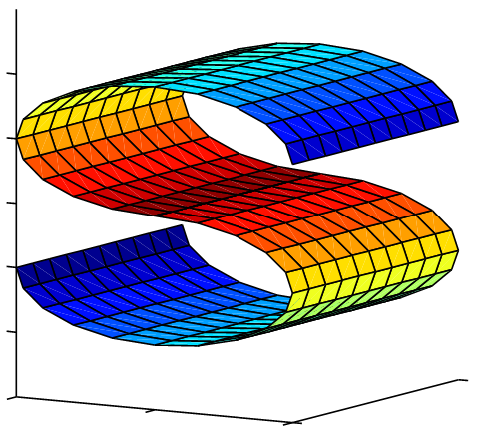
K-means: about distance
Distance measure
Each measure provides a view on data
There are infinite number of distance measures
Which distance is good?
Similarity measures can be used
Similarity between two objects

Slide 15
K-means: affects of outliers
K-means is sensitive with outliers, i.e., outliers might affect significantly on clustering results.
Outliers are instances that significantly differ from the normal instances.
The attribute distributions of outliers are very different from those of normal points.
Noises or errors in data can result in outliers.

Slide 16
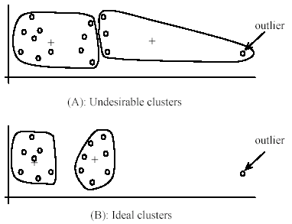
K-means: outlier example
[Liu, 2006]

Slide 17
K-means: outlier solutions
Outlier removal: we may remove some instances that are significantly far from the centroids, compared with other instances.
Removal can be done a priori or when learning clusters.
Random sampling: instead of clustering all data, we take a random sample S from the whole training data.
S will be used to learn K clusters. Note that S often contains fewer noises/outliers than the original training data.
After learning, the remaining data will be assigned to the learned clusters.

Slide 18
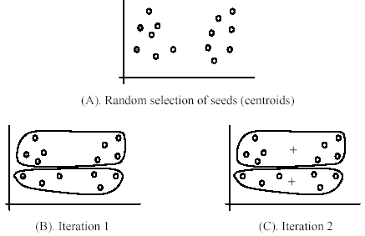
K-means: initialization
Quality of K-means depends much on the initial centroids.
1st centroid
2nd centroid
[Liu, 2006]

Slide 19
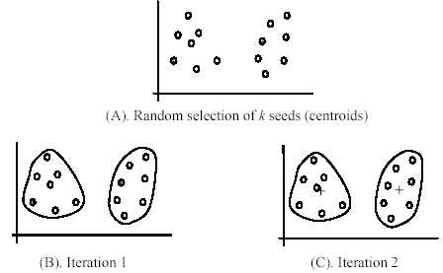
K-means: initialization solution (1)
We repeat K-means many times
Each time we initialize a different set of centroids.
After learning, we combine results from those runs to obtain a unified clustering.
[Liu, 2006]

Slide 20
K-means: initialization solution (2)
K-means++: to obtain a good clustering, we can initialize the centroids from D in sequence as follows
Select randomly the first centroid m₁.
Select the second centroid which are farthest to m₁.
…
Select i^{th} centroid which are farthest from {m₁, …, m_{i-1}}.
…
By using this initialization scheme, K-means can converge to a near optimal solution [Arthur, D.; Vassilvitskii, 2007]

Slide 21
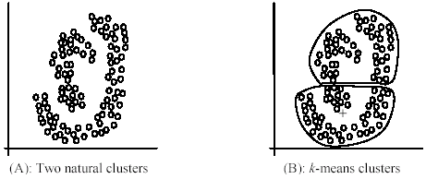
K-means: curved clusters
When using Euclidean distance, K-means cannot detect non-spherical clusters.
How to deal with those cases?
[Liu, 2006]

Slide 22
K-means: summary
Advantages:
Be very simple,
Be efficient in practice,
Converges in expected polynomial time [Manthey & Röglin, JACM, 2011]
Be flexible in choosing the distance measures.
Limitations:
Choose a good similarity measure for a domain is not easy.
Be sensitive with outliers.

Slide 23
4. Online K-means
K-means:
We need all training data for each iteration.
Therefore, it cannot work with big datasets,
And cannot work with stream data where data come in sequence.
Online K-means helps us to cluster big/stream data.
It is an online version of K-means [Bottou, 1998].
It follows the methodology from online learning and stochastic gradient.
At each iteration, one instance will be exploited to update the available clusters.

Slide 24
Revisiting K-means
Note that K-means finds K clusters from the training instances {x₁, x₂, …, x_{M}} by minimizing the following loss function:
Where w(x_{i}) is the nearest centroid to x_{i}.
Using its gradient, we can minimize Q by repeating the following update until convergence:
Where γ_{t} is a small constant, often called learning rate.
This update will converge to a local minimum.

Slide 25
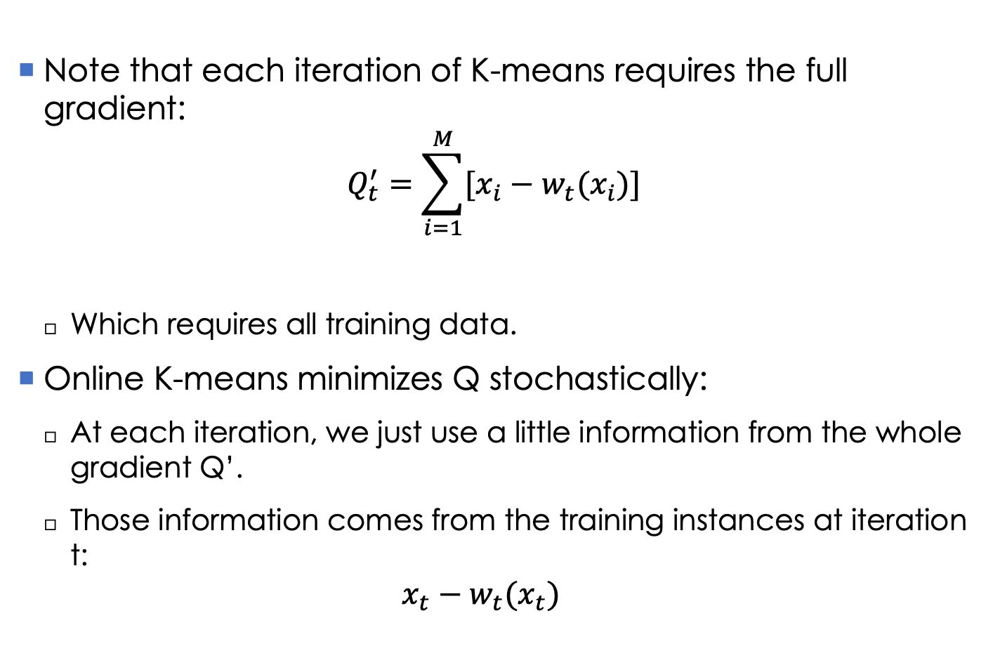
Online K-means: idea
Note that each iteration of K-means requires the full gradient:
$$Q_{t}^{′}=\sum_{i=1}^{M}{[x_{i}−w_{t}(x_{i})]}$$
Which requires all training data.
Online K-means minimizes Q stochastically:
At each iteration, we just use a little information from the whole gradient Q’.
Those information comes from the training instances at iteration t:
$$x_{t}−w_{t}(x_{t})$$

Slide 26
Online K-means: algorithm
Initialize K centroids randomly.
Update the centroids as an instance comes
At iteration t, take an instance x_{t}.
Find the nearest centroid w_{t} to x_{t}, and then update w_{t} as follows:
Note: the learning rates are positive constants, which should satisfy

Slide 27
Online K-means: learning rate
A popular choice of learning rate:
τ, κ are possitive constants.
κ ∈ (0.5, 1] is called forgeting rate. Large κ means that the algorithm remembers the past longer, and that new observations play less and less important role as t grows.

Slide 28
Convergence of Online K-means
Objective Q decreases as t increases.
Online K-means (Black circles), K-means (Black squares)
Partial gradient (empty circles), full gradient (empty squares)
Q

Slide 29
References
Arthur, D.; Vassilvitskii, S. (2007). K-means++: the advantages of careful seeding. Proceedings of the 18th annual ACM-SIAM symposium on Discrete algorithms, pp. 1027–1035.
Arthur, D., Manthey, B., & Röglin, H. (2011). Smoothed analysis of the k-means method. Journal of the ACM (JACM), 58(5), 19.
Bottou, Léon. Online learning and stochastic approximations. On-line learning in neural networks 17 (1998).
B. Liu. Web Data Mining: Exploring Hyperlinks, Contents, and Usage Data. Springer, 2006.
Lloyd, S., 1982. Least squares quantization in PCM. IEEE Trans. Inform. Theory 28, 129–137. Originally as an unpublished Bell laboratories Technical Note (1957).
Jain, A. K. (2010). Data clustering: 50 years beyond K-means. Pattern recognition letters, 31(8), 651-666.

Slide 30
Exercises
Solutions to K-means when the data distributions are not spherical?
How to decide a suitable cluster for a new instance?

